Slide 1

Dynamic Mobile Sensing Platform
Wrap up Meeting
Yuzhou Tong 27/6/2023

Slide 2
Outline
Platform Architecture
Data Collection
Data Transmission
Data Visualization
Outdoor Tests
Test Set-up
Data and Results
Future Improvements
Stable Connection
Online Visualization

Slide 3
Platform Architecture

Slide 4
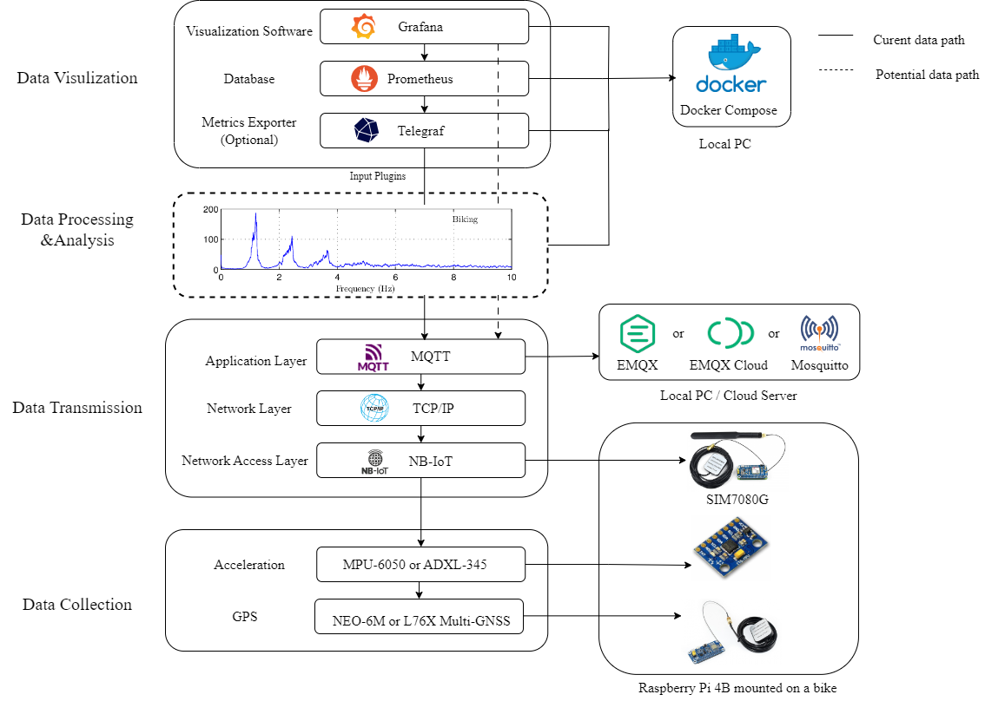
Architecture

Slide 5
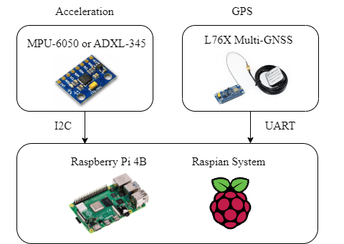
Data Collection

Slide 6
GPS Module
Specifications | Value
Capturing Time (cold start) | 10 seconds
Capturing Time (hot start) | 1 seconds
Refreshing Frequency | < 10 Hz
Positioning Accuracy | < 2.5 m
Receiving Signal | GPS, BD2, and QZSS
Communication Interface | UART
Baud Rate | 115200
Communication Protocol | NMEA

Slide 7
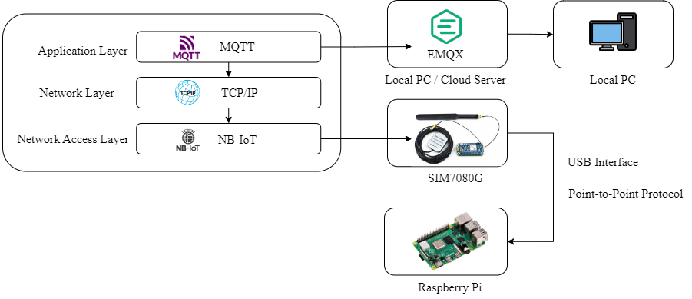
Data Transmission

Slide 8
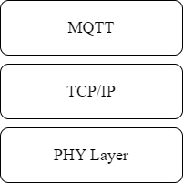
MQTT
Message Queuing Telemetry Transport (MQTT) is a widely used transmission protocol in IoT applications
It is lightweight, simple, and open, which makes it suitable for machine-to-machine (M2M) communications
MQTT runs on top of the Transmission Control Protocol/Internet Protocol (TCP/IP) stack

Slide 9
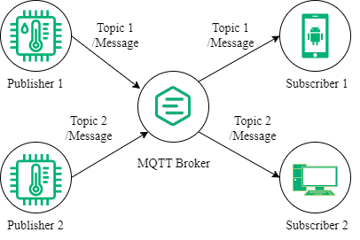
MQTT Protocol
A Publisher sends messages to a topic in the MQTT broker
A Subscriber can subscribe multiple topics
The MQTT Broker pass each topic’s messages to its subscribers

Slide 10
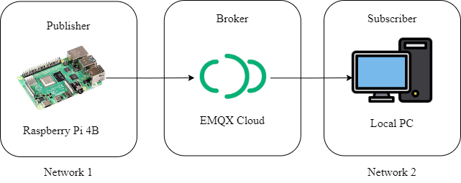
MQTT Broker
Easy to deploy, easy to get access
A free account is enough for our project
EMQX also has a public broker

Slide 11
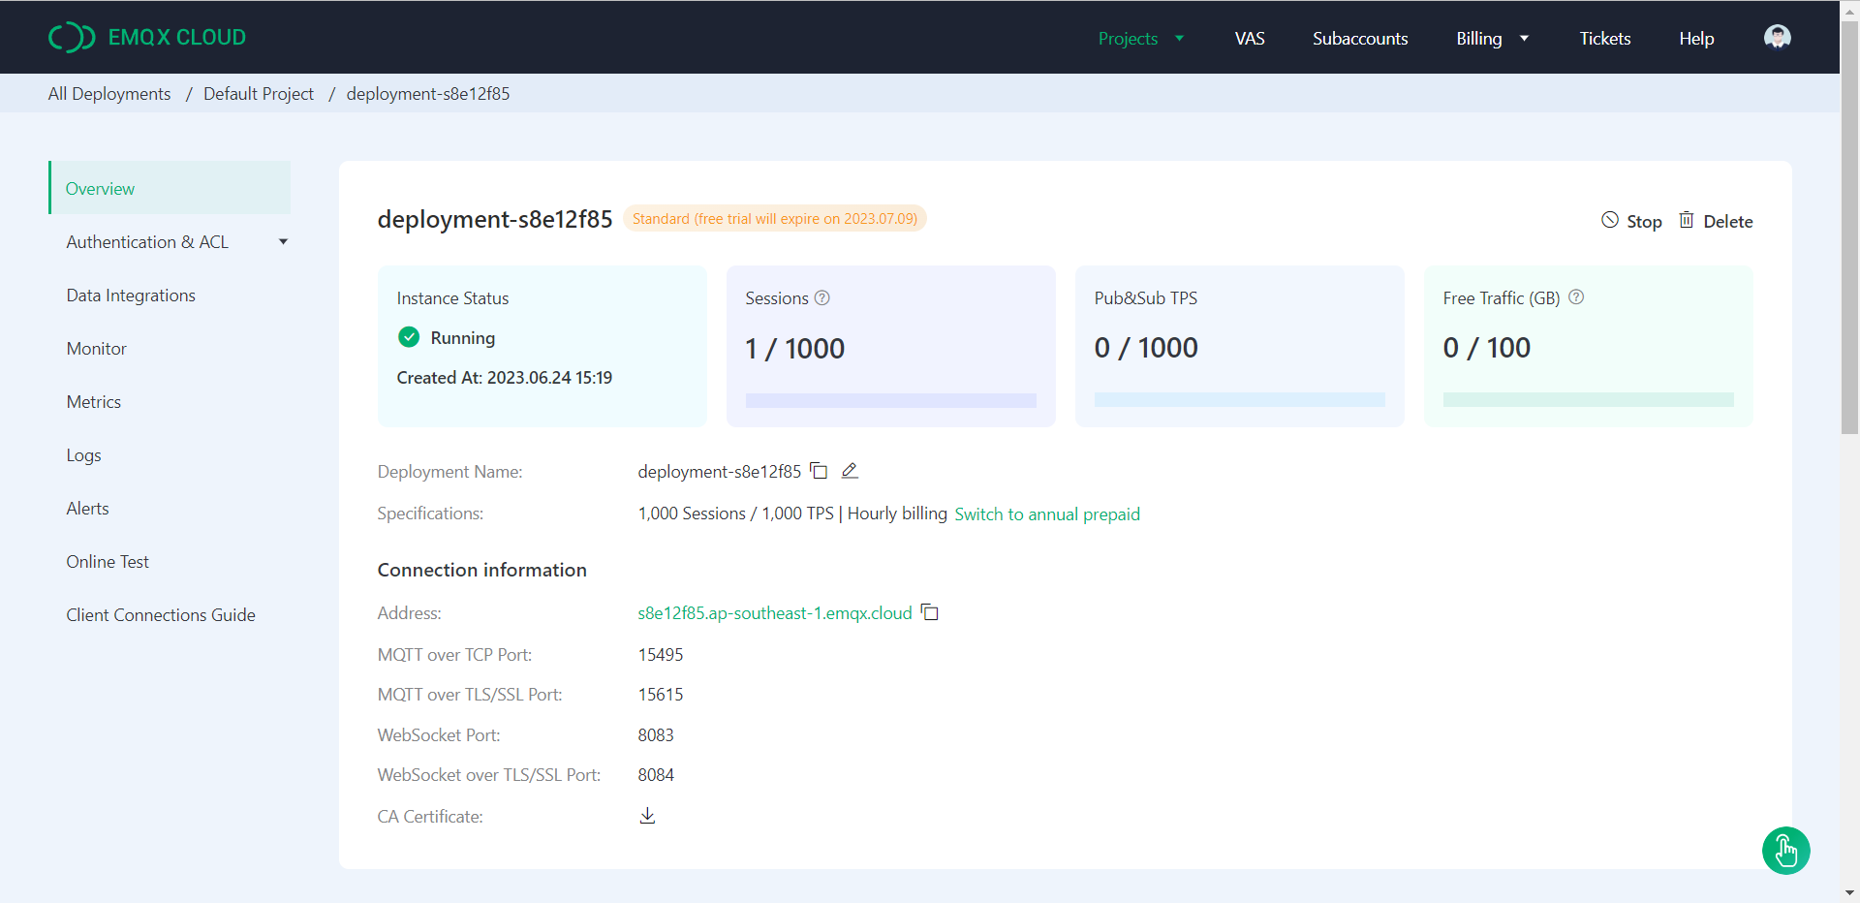
EMQX Cloud

Slide 12
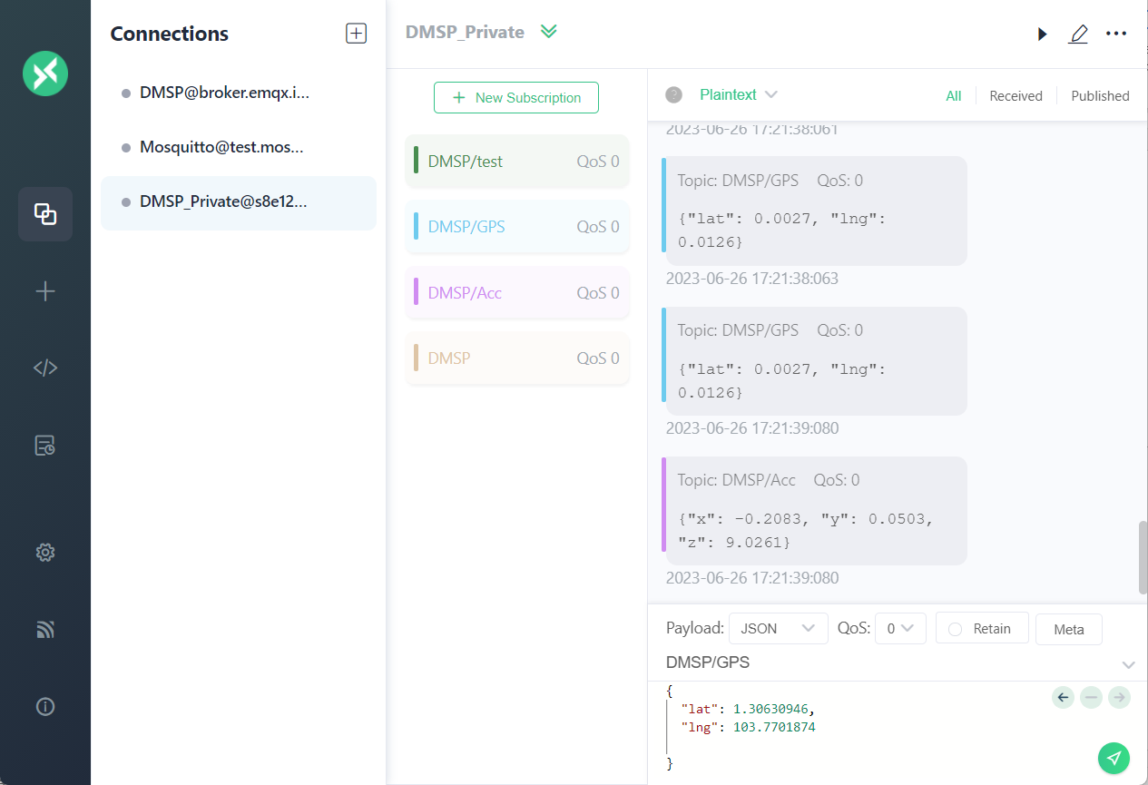
MQTTX

Slide 13
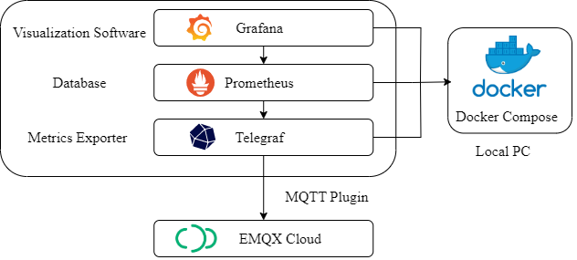
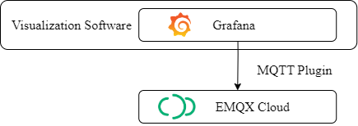
Data Visualization
Telegraf for processing and export the data
Prometheus as a database for storing data
Grafana for visualization
Grafana also supports MQTT as the data source directly
Have some bugs

Slide 14
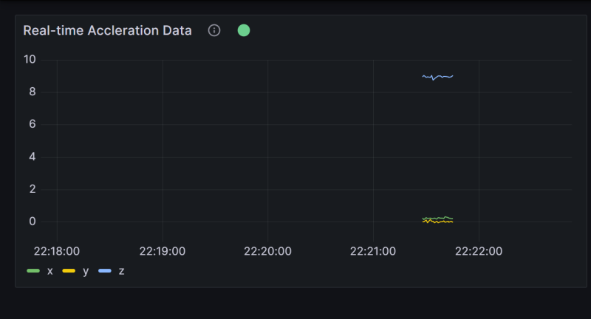
Grafana MQTT Plugin
Unstable: sometimes stop streaming after 15 seconds
Simple for configuration
Will be fixed soon

Slide 15
Outdoor Test

Slide 16
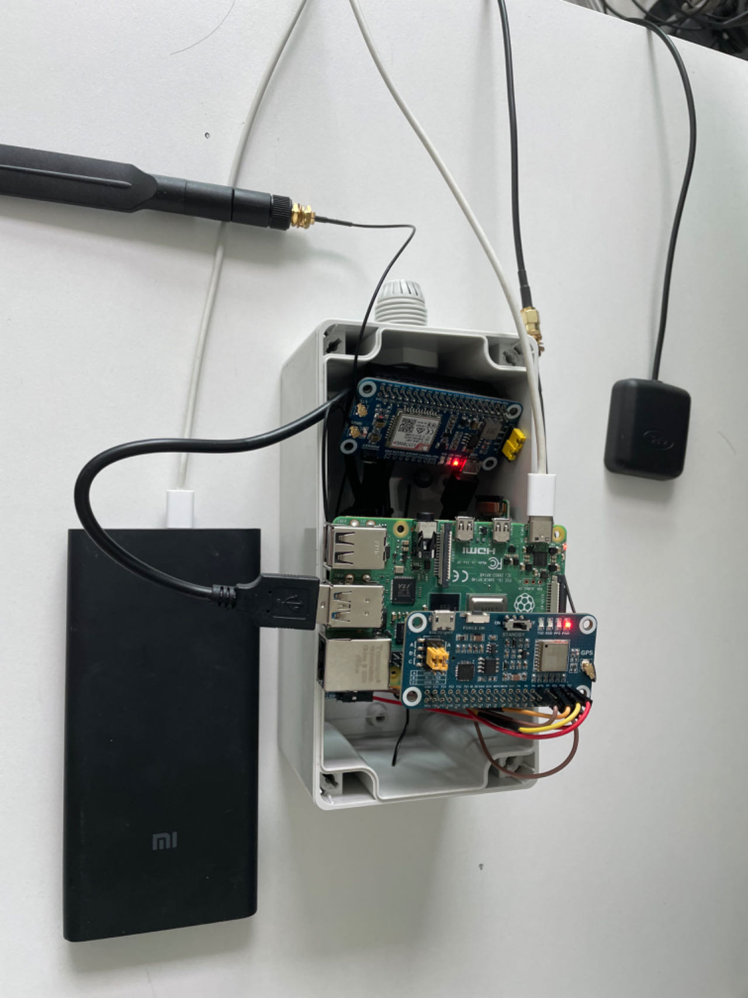
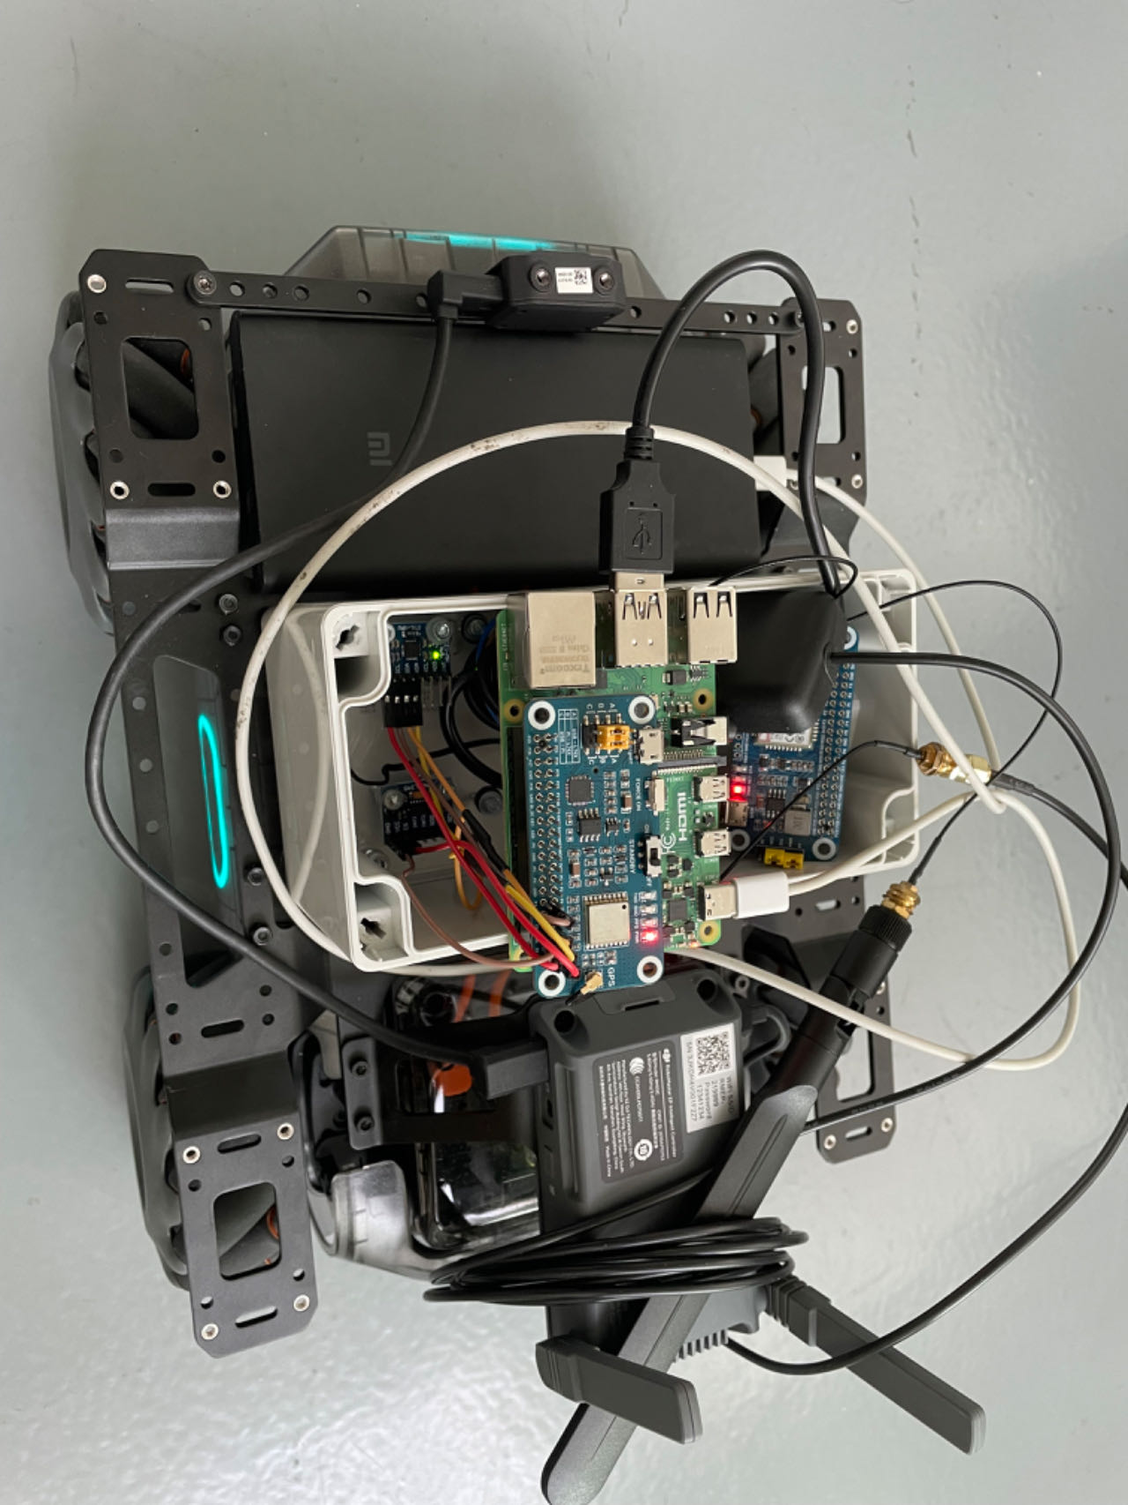
Test Set-up

Slide 17
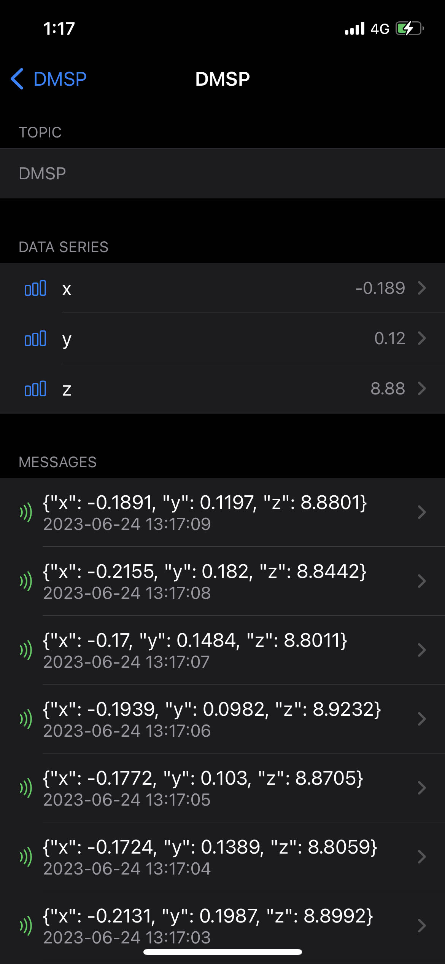
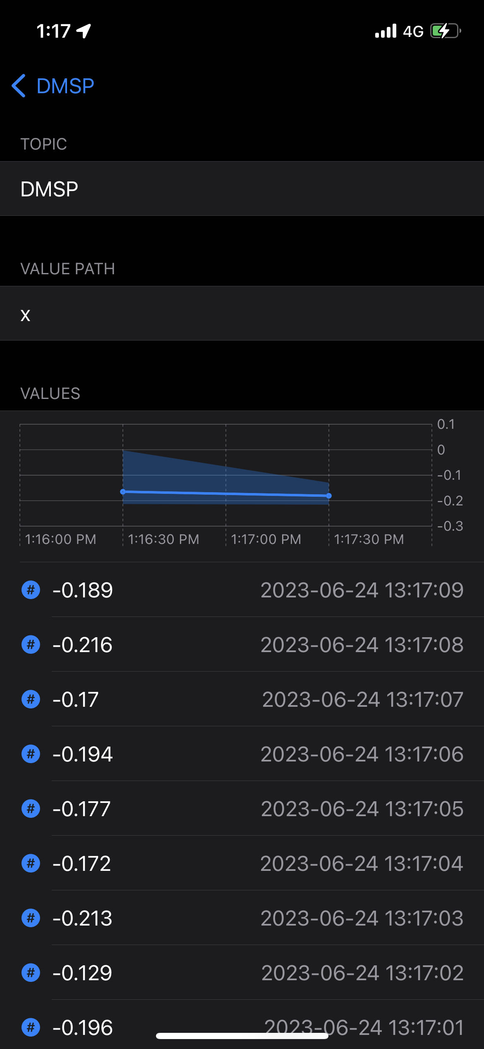
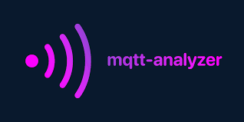
Test Set-up
A mobile application for subscribing and publishing MQTT messages
A good tool to monitor the data in the outdoor environment

Slide 18
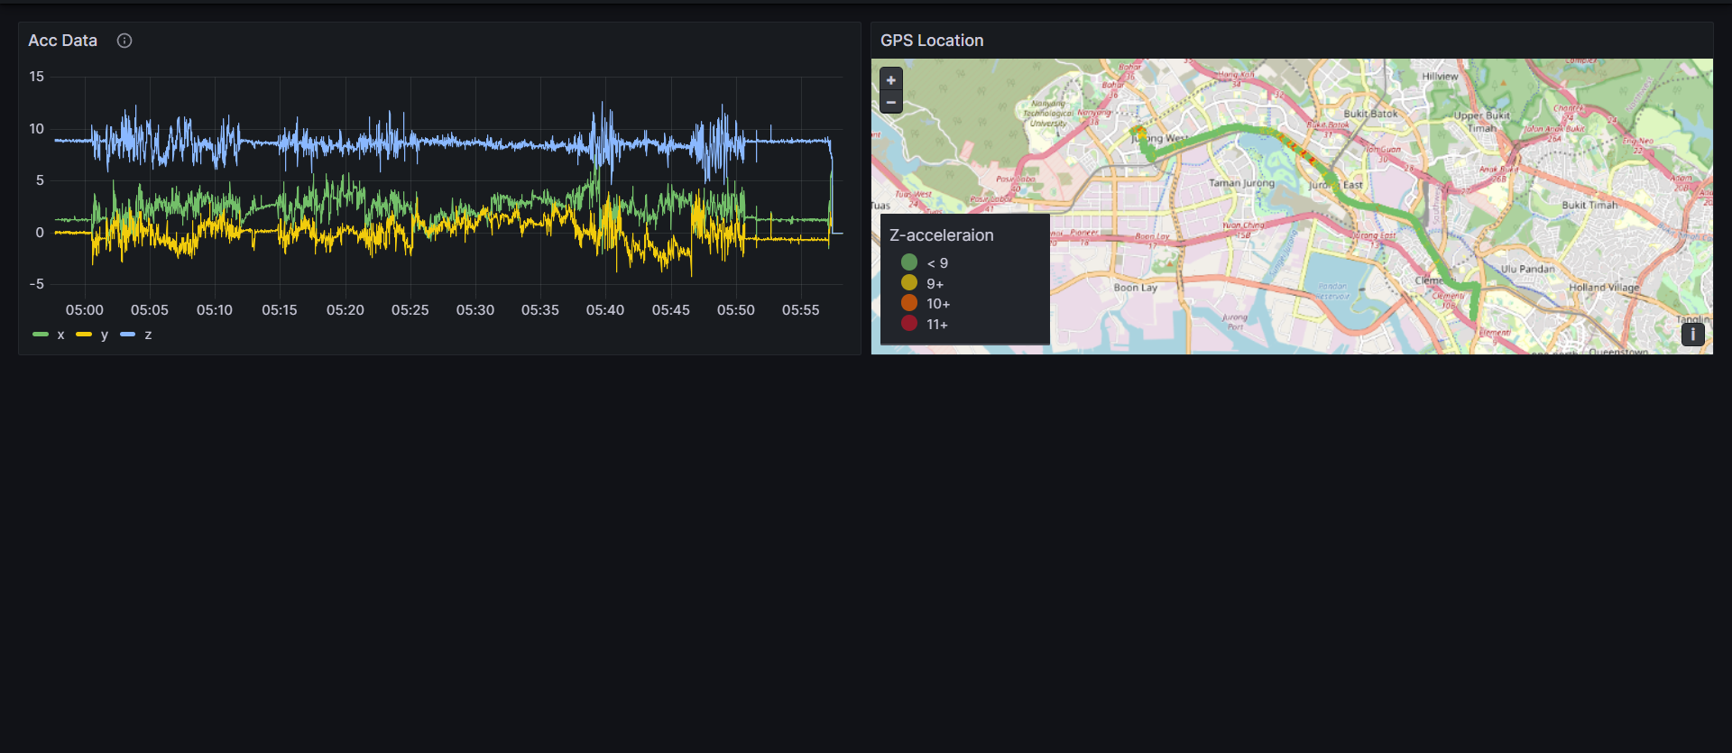
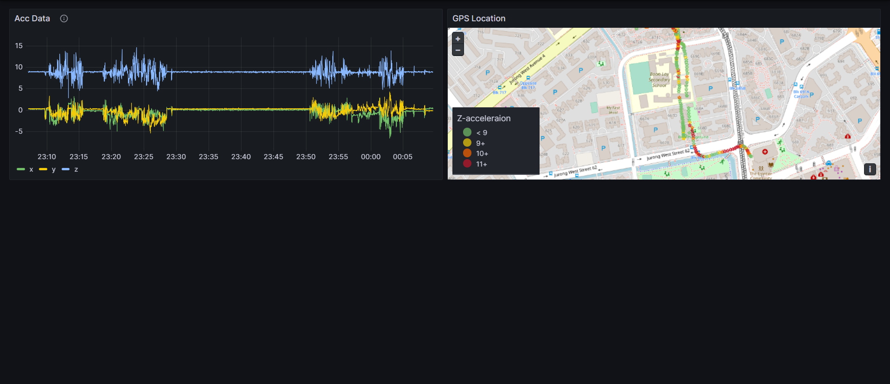
Data Visualizations
The Near Distance Test
The Long Distance Test

Slide 19
Future Improvements

Slide 20
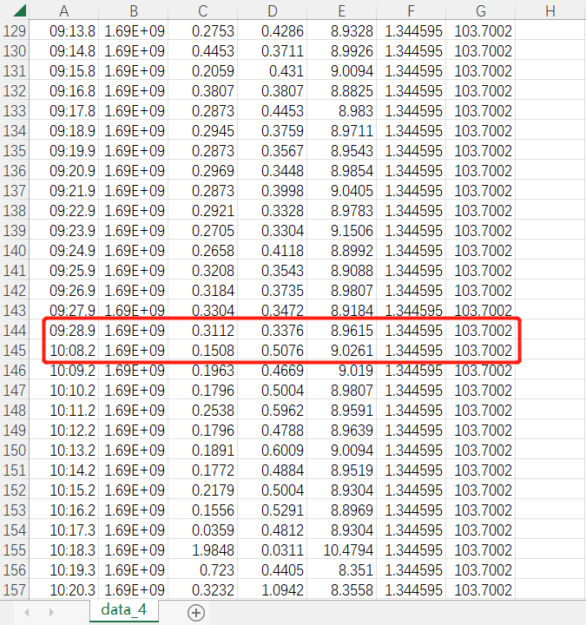
Stable Connection
Point-to-Point connection not reliable
A script for detecting and rebuilding connections
Packet Loss

Slide 21
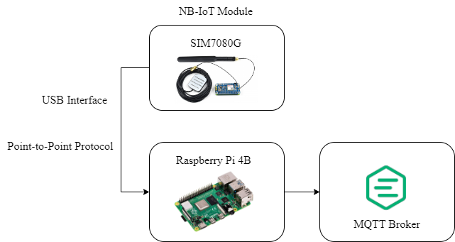
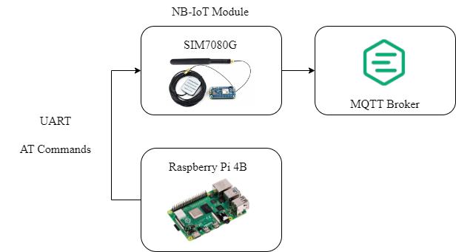
Stable Connection
Previous layout: use python MQTT library to send messages through Raspberry Pi
Improved layout: use AT commands to send MQTT messages directly through the NB-IoT module

Slide 22
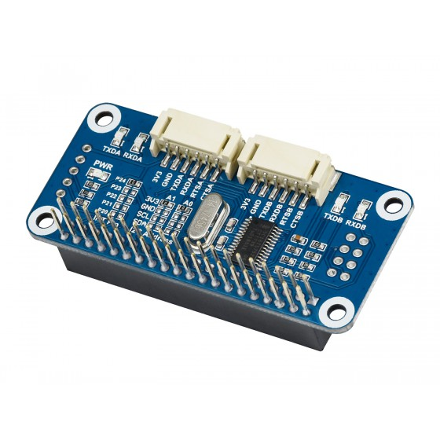
Stable Connection
Both GPS and NB-IoT module use the UART interface
They work at different baud rates and have pin conflicts
An expansion hat is required
Serial Expansion HAT for Raspberry Pi

Slide 23

Online Visualization
Deploy Grafana on a cloud server
Or directly use Grafana Cloud

Slide 24
Q & A

Slide 25
Thanks for your time !

